Slide 1

Welcome to our Rubikc Cube Game

Slide 2

Team Members
Prakash Shah(205028)
Sagar Goswami(205040)

Slide 3

What is Rubikc ?
Rubikc: The Rubikc, The Rubic's Cube is a 3-D combination puzzle originally invented in 1974 by Hungarian sculptor and professor of architecture Ernő Rubik.

Slide 4
Aim
This, “Rubikc” cube project aims to make a Rubic Cube game using Unity3D Game engine for demonstration of Technology learned by students of BCA Semester 6.
This is a Simple game which aims to show how basic technologies can be used to create a simple and real-life like games and entertainment. For this, we need a game that is user-friendly, Simple and eye-catching.
This game will be made using basic technologies such C#, Mono, .NET Core 7, Unity engine and Unity’s own API for Gamplay programming.

Slide 5


Tools
Languages
C#
.NET Core 7
Mono
Unity Scripting API
WebGL
Microsoft Visual Studio
Photoshop
Blender
Git and GitHub
Unity 3D Game Engine

Slide 6
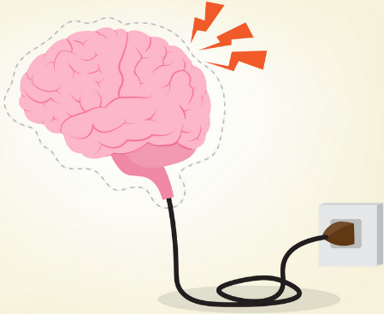
Benefits
Improve your memory.
Keeps your mind active.
Improves your speed.
Enhances concentration and configuration.
Helps to develop problem-solving skills.
Enhances Brain-Hand-Eye coordination and Reflexes.
No need for physical rubic cube.
Portable and free.

Slide 7
Features
The whole cube can be rotated on the axis of game world.
Once a side is touched, all the edge cube are grouped to that side’s center piece to allow partial rotation.
The centre piece is Fixed on game centre around which all side can be rotated
Each touch is registered through collision on cube surface and rigidbody3D Component.
3x3 Rayscasts are fired to the cube which is touches the cube surface broadcasts the cube surface to corresponding cube-map tile.
User can shuffle the cube without any restriction to get a random state.
If Stuck, the user can use solve button which kicks the kochiemba’s 2 phase cube solving algorithm which solves the cube in less than 22 moves regardless of cube state.

Slide 8
Limitations
1. Haven’t implemented different cube size than 3x3.
2. More Platform can be supported like Xbox, Playstation and Nintendo Switch.
3. Haven’t tested on MacOS or Android Devices although likely portable.

Slide 9
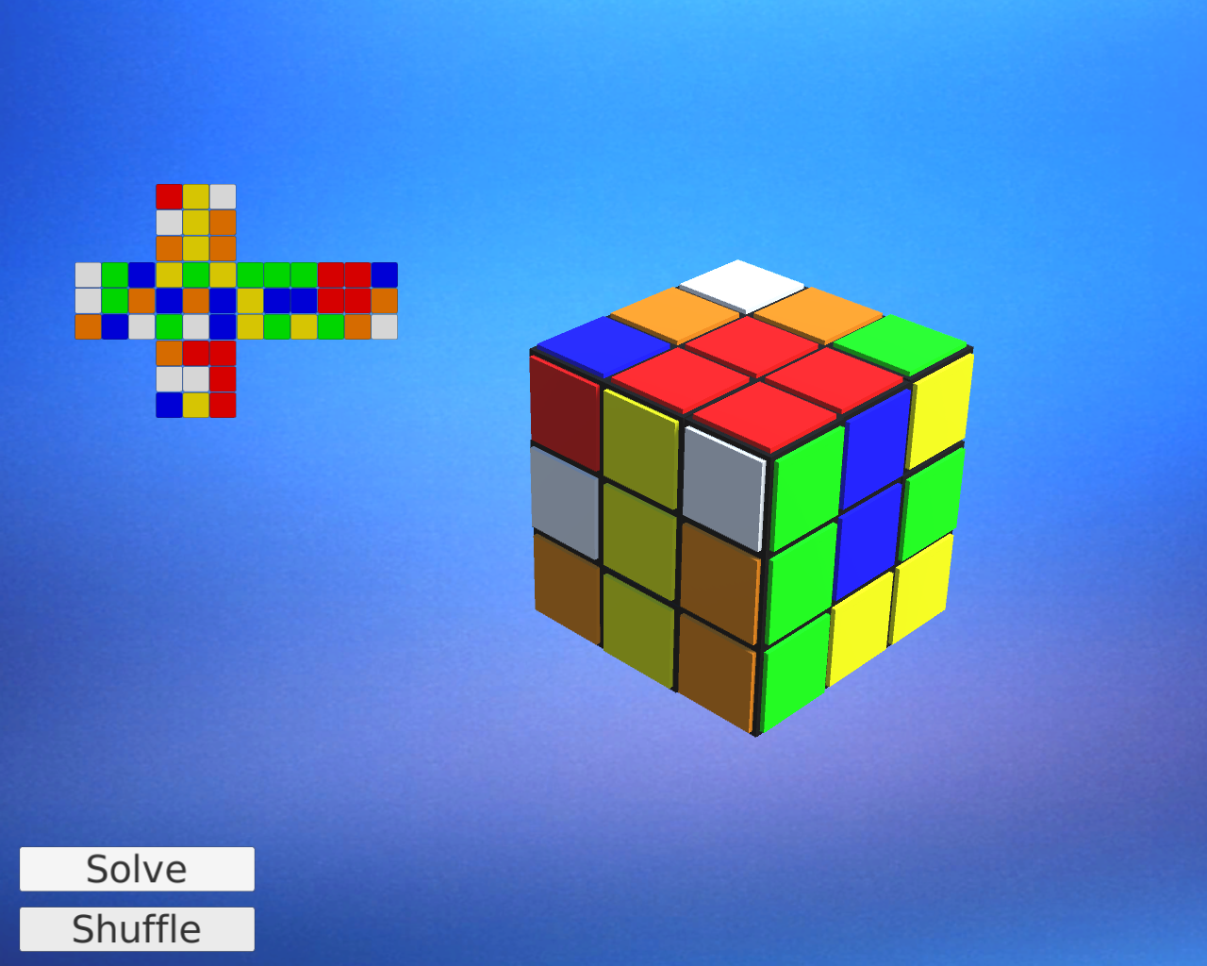
Shuffled State

Slide 10
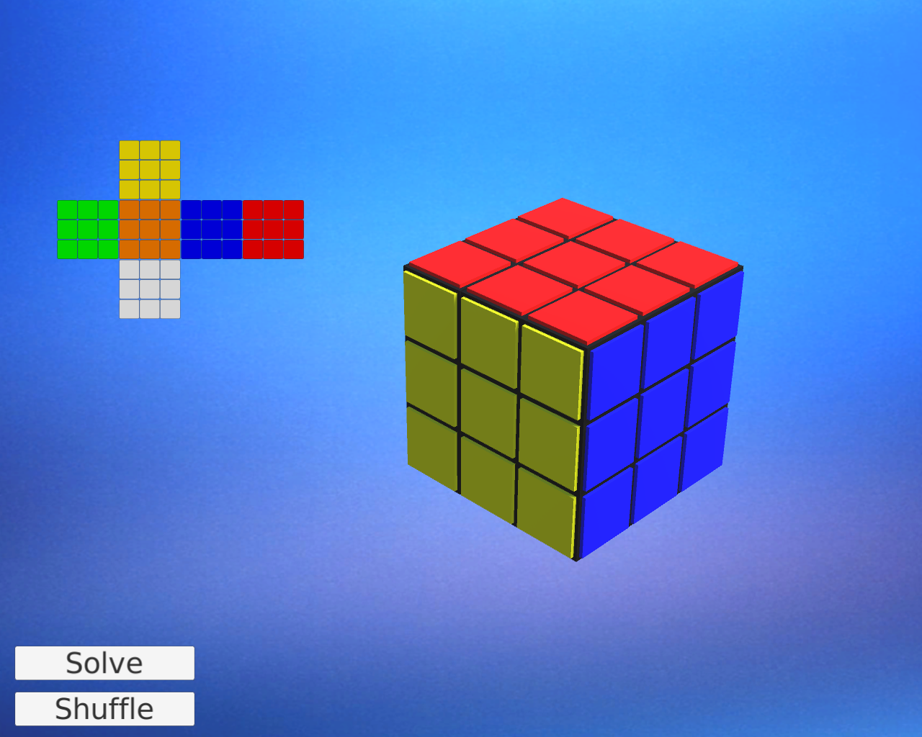
Solved Cube

Slide 11
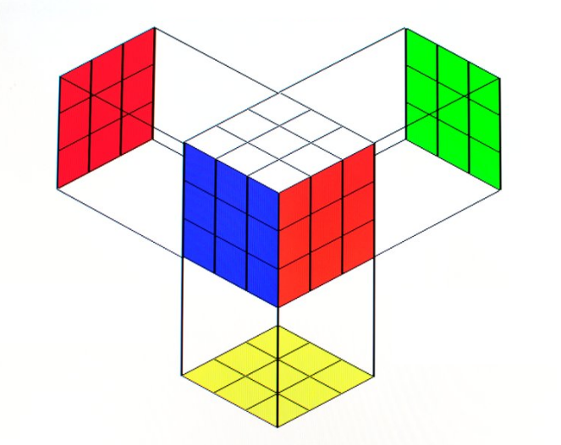
Cube Facelets
Raycasts are fired from front and if collision is detected on cube surface then it is brodcasted on Cubemap.

Slide 12
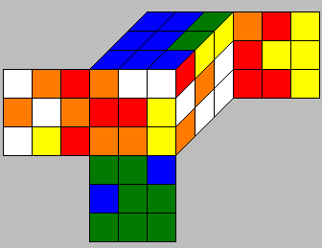
Kociemba's algorithm?
Kociemba's algorithm is a method for solving the Rubik's Cube puzzle. It is a more advanced method than the beginner's method, which involves solving the cube layer by layer. Kociemba's algorithm is named after its creator, Herbert Kociemba, who developed it in the 1990s.
Kociemba's algorithm uses a two-phase approach to solve the Rubik's Cube. In the first phase, the corners of the cube are solved. In the second phase, the edges are solved. The two phases are completely independent, meaning that the algorithm solves the corners first and then the edges, rather than solving both at the same time.

Slide 13
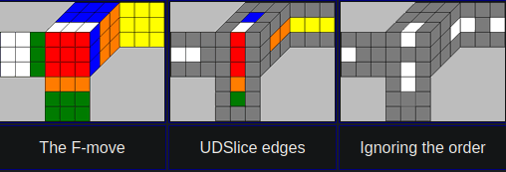
Kociemba's algorithm:
The algorithm uses a sophisticated search strategy that involves analyzing the possible moves that can be made from a given cube state, and then selecting the move that will bring the cube closer to the solved state. This process is repeated until the cube is solved. Kociemba's algorithm is highly optimized, and can solve the Rubik's Cube in an average of 21 moves or less, which is much more efficient than the beginner's method.
Overall, Kociemba's algorithm is a highly effective method for solving the Rubik's Cube, and it is used by many speedcubers around the world.

Slide 14
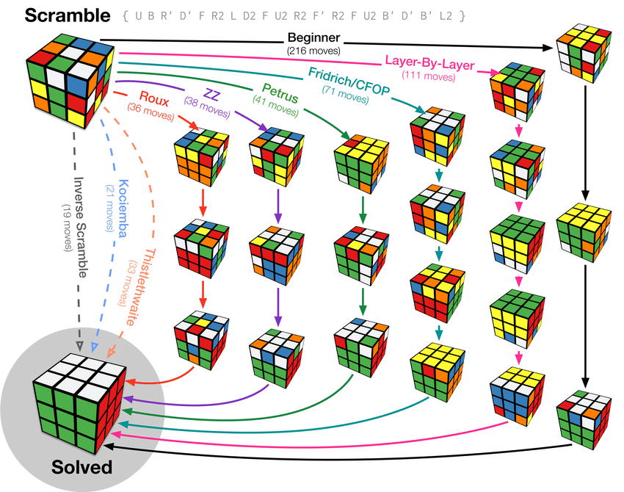
Kociemba's Efficiency:

Slide 15
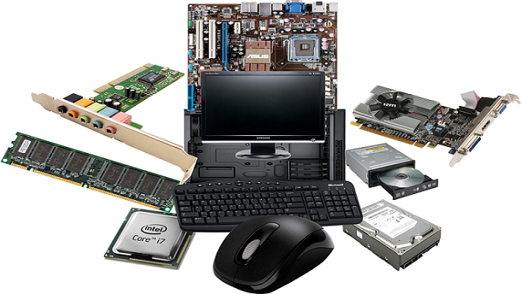
Hardware requirements
1.5 GHz processor or higher.
2 GB RAM or higher.
500 MB Available Hard Drive Space
Windows 7 SP2 or later operating system OR Any LINUX distribution or MAC OS.
An active Internet Connection.(not requied for gameplay)

Slide 16

Software requirements
Any Modern OS.
Visual Studio Code.
Git and GitHub.
Unity3D
Blender
UnityAPI

Slide 17
References
Technology References:
C# (https://learn.microsoft.com/en-us/dotnet/csharp/ )
.NET Core (https://dotnet.microsoft.com/en-us/learn/dotnet/what-is-dotnet )
Mono(https://www.mono-project.com/ )
Unity3D(https://unity.com/ )
Unity Scripting API(https://jquery.com/ )
LibreOffice(https://www.libreoffice.org/discover/libreoffice/)
Documentation References:
Unity Documentation (https://docs.unity3d.com/Manual/index.html )
kociemba Algorithm (http://kociemba.org/ )
Others:
Git SCM(https://git-scm.com/ )
GitHub(https://github.com/ )
Composite reference:
Google (https://www.google.co.in/ )
Project Repo(https://github.com/Prakash4844/Rubikc )
Team-members:
Prakash (205028)
Sagar Goswami (205040)

Slide 18

Any Question ?

Slide 19


